Slide 1


Employee MyBenefits Portal Tutorial
Change Beneficiary

Slide 2
Before We Begin
Slide 2 of 12
You must be logged into the NMPSIA MyBenefits Portal before
completing this tutorial.
If you are a new user, forgot your password, or experience login issues, please refer to the Employee Login Tutorial https://nmpsia.com/enrollment-tutorials.html for complete step-by-step instructions.
Important Reminders
• MFA codes expire after 5 minutes.
• Use the email associated with your NMPSIA benefits.
• Check your Spam or Junk folder if you do not receive your code.
Need help logging in?
Please refer to the Employee Login Tutorial before continuing.
The Employee Login Tutorial includes:
✔ First-Time Login
✔ Password Creation
✔ MFA Verification
✔ Common Login Errors
Go to NMPSIA.com
↓
Benefits Portal Login
↓
Select Employee
↓
Login with Email
↓
Complete MFA Verification
↓
Enter Password
↓
Access MyBenefits Portal
After you have successfully logged into the Employee MyBenefits Portal, continue to the next slide.

Slide 3
Before You Begin
Slide 3 of 12
Before updating your beneficiary information, please review the following information:
Beneficiary changes can be made at any time during the year.
Review your current beneficiary information before making changes.
Have your beneficiary’s personal information ready before you begin, including:
Beneficiary's full legal name
Date of Birth
Relationship to you
Beneficiary's Mailing Address
Percentage allocation (if adding multiple beneficiaries)
If adding multiple beneficiaries, ensure the total percentage allocation equals 100%.
Enter all information accurately to help avoid processing delays.
Helpful Tip
Keeping your beneficiary information current helps ensure your benefits are distributed according to your wishes.

Slide 4
Transaction Overview
Slide 4 of 12
Helpful Tip
Gather all beneficiary information before starting to make the update process faster and easier.
This tutorial will show you how to:
Complete required information
Review your entries
Submit the transaction

Slide 5
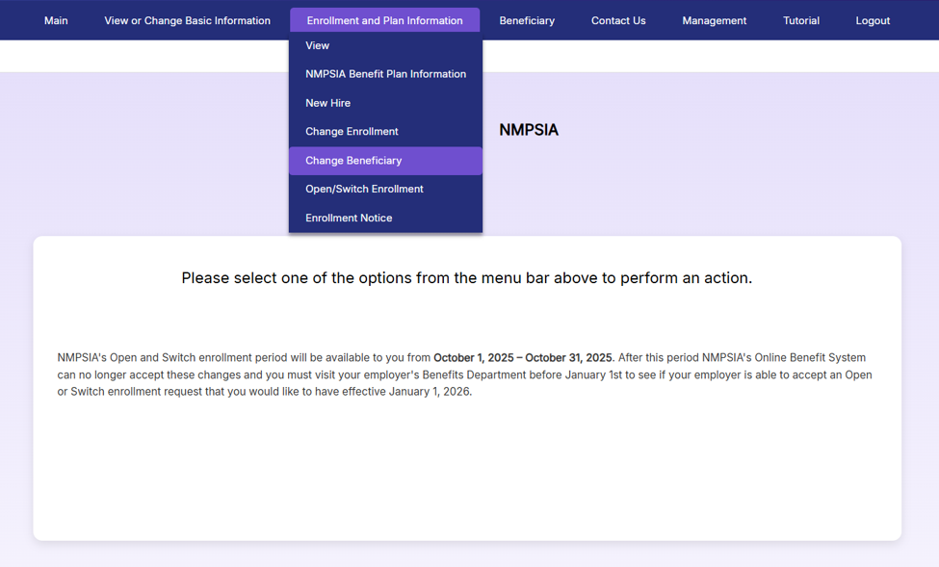
Step 1
Slide 5 of 12
From the Home page
Navigate to the Enrollment and Plan Information tab.
Choose Change Beneficiary
Helpful Tip
If you are uncertain who you may have listed as your current beneficiary, visit the Beneficiary tab to view the current record before proceeding with the instructions above.

Slide 6
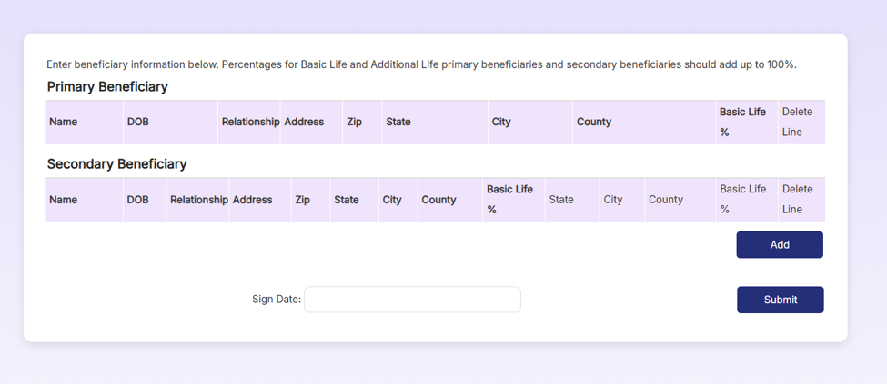
Step 2
Slide 6 of 12
To begin with assigning a beneficiary, select Add.
Helpful Tip
If you have multiple beneficiaries, add each beneficiary separately and verify the correct percentage allocation for each.

Slide 7
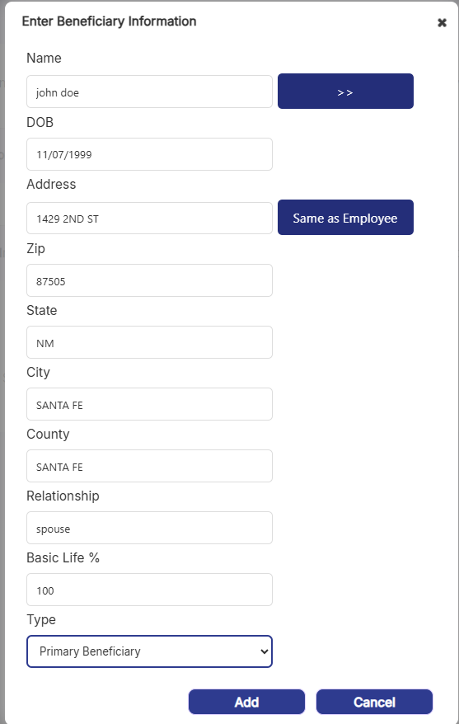
Step 3
Slide 7 of 12
When the pop-up menu appears:
Enter all required beneficiary information.
Choose Primary or Secondary Beneficiary
If more than one Primary or Secondary Beneficiary, make sure percentage equals 100%
Select Add.
1
Helpful Tip
Enter the beneficiary's legal name exactly as it appears on official documents.
3
2
4

Slide 8
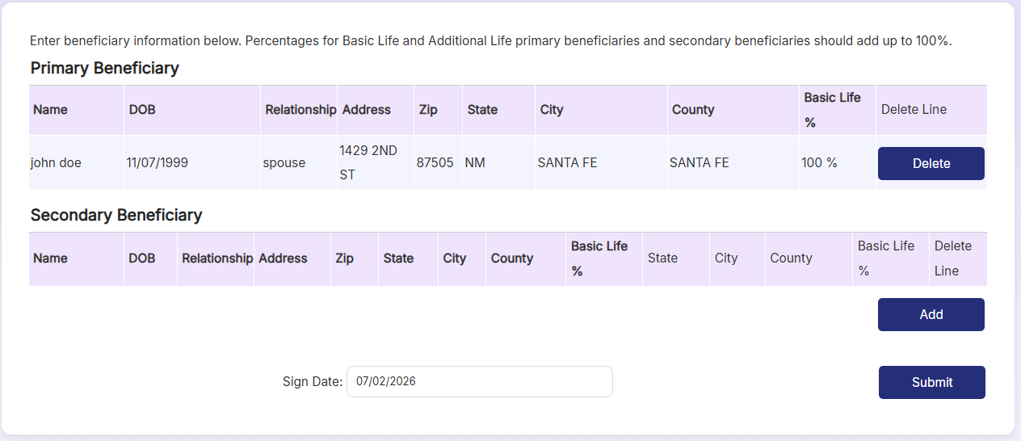
Step 4
Slide 8 of 12
Review the entry for accuracy
Select Submit
1
Helpful Tip
Take a moment to review your information before submitting. Correct information helps prevent future issues.
2

Slide 9
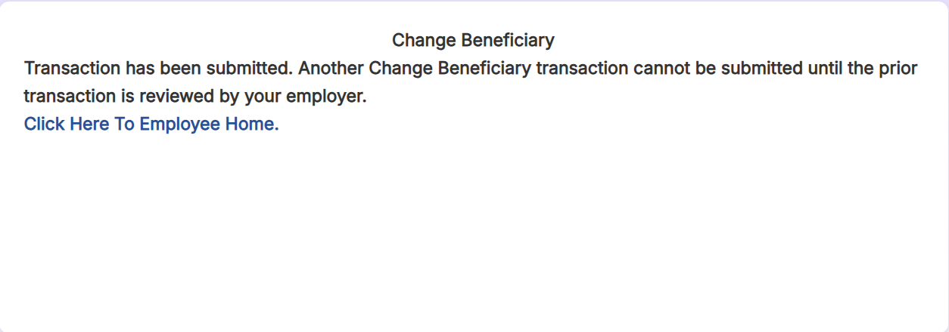
After Submission
Slide 9 of 12
A confirmation message will appear showing that your transaction was successfully submitted.

Slide 10
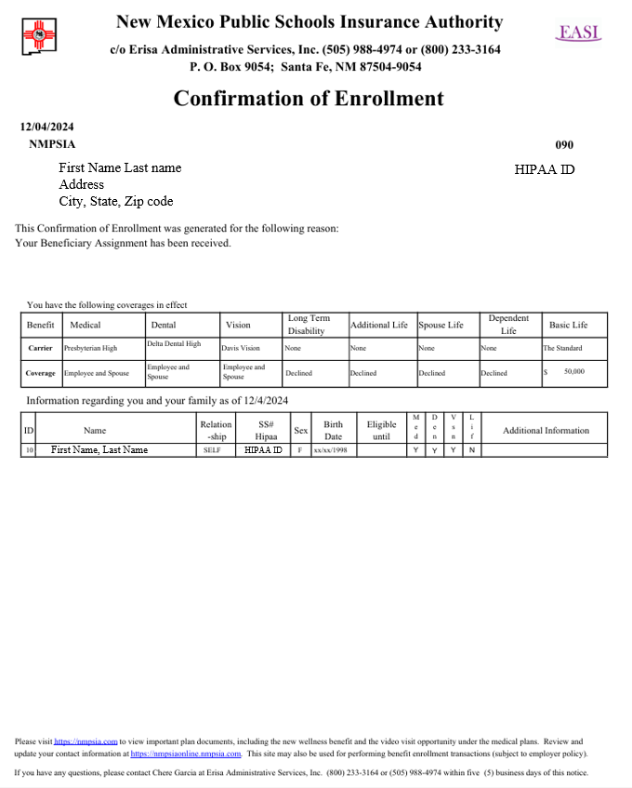
After Processing
Slide 10 of 12
After your request is reviewed and approved by your employer it will be submitted to EASI Edu for processing.
EASI Edu will process within 4 days of your employer’s submission.
Review your Confirmation of Enrollment to verify your update to beneficiary information was successful.
Helpful Tip
To view a digital version of the Confirmation, navigate to the Enrollment and Plan Information
then click Enrollment Notice.

Slide 11
Common Errors
Slide 11 of 12
Helpful Tip
Carefully review all beneficiary information before submitting.
Missing Required Information – Make sure all required fields are complete
Percentage allocation does not equal 100% – If adding multiple beneficiaries, ensure all percentages total 100%.
Duplicate beneficiary entered – Review your existing beneficiaries before adding another beneficiary.
Authentication code expired – Request a new Multi-Factor Authentication (MFA) code and sign in again.
Session timed out – Log back into the MyBenefits Portal and restart the your request.
Changes were not submitted – Review your information and be sure to select Submit before leaving the page.

Slide 12
Need Assistance?
Slide 12 of 12
Thank you for using the NMPSIA MyBenefits Portal!
Contact Us:
EASI Edu
Phone: 1-800-233-3164
Contact your assigned representative for portal assistance.
Or
NMPSIA Benefits Team
Phone: 1-800-548-3724

